Slide 1

CSE 105 Data Structures

Slide 2
These were the basics of programming
The ability to manipulate the computer to perform the required tasks
You saw data storage techniques:
Arrays, and
Linked lists (collections were discussed)
You saw array accessing/manipulation techniques:
Searching, and
Sorting

Slide 3
In this course, we will look at:
Data structures for efficiently storing, accessing, and modifying data
Algorithms for solving problems efficiently
We will see that all data structures have trade-offs
There is no ultimate data structure...
The choice depends on our requirements

Slide 4
Justification
However, as engineers, you will not be paid to say:
Method A is better than Method B
or
Algorithm A is faster than Algorithm B
Such comparisons are said to be qualitative:
qualitative, a. Relating to, connected or concerned with, quality or qualities.
Now usually in implied or expressed opposition to quantitative.
OED

Slide 5
Justification
Qualitative statements cannot guide engineering design decisions:
Algorithm A could be better than Algorithm B, but Algorithm A would require three person weeks to implement, test, and integrate while Algorithm B has already been implemented and has been used for the past year
There are circumstances where it may beneficial to use Algorithm A, but not based on the word better

Slide 6
Justification
Thus, we will look at a quantitative means of describing data structures and algorithms:
quantitative, a. Relating to, concerned with, quantity or its measurement; ascertaining or expressing quantity. OED
This will be based on mathematics, and therefore we will look at a number of properties which will be used again and again throughout this course

Slide 7
Floor and ceiling functions
The floor function maps any real number x onto the greatest integer less than or equal to x:
Consider it rounding towards negative infinity
The ceiling function maps x onto the least integer greater than or equal to x:
Consider it rounding towards positive infinity
The cmath library implements these as
double floor( double ); double ceil( double );

Slide 8
Logarithms
We will begin with a review of logarithms:
If n = e^{m}, we define
m = ln( n )
It is always true that e^{ln(n)} = n; however, ln(e^{n}) = n requires that n is real

Slide 9
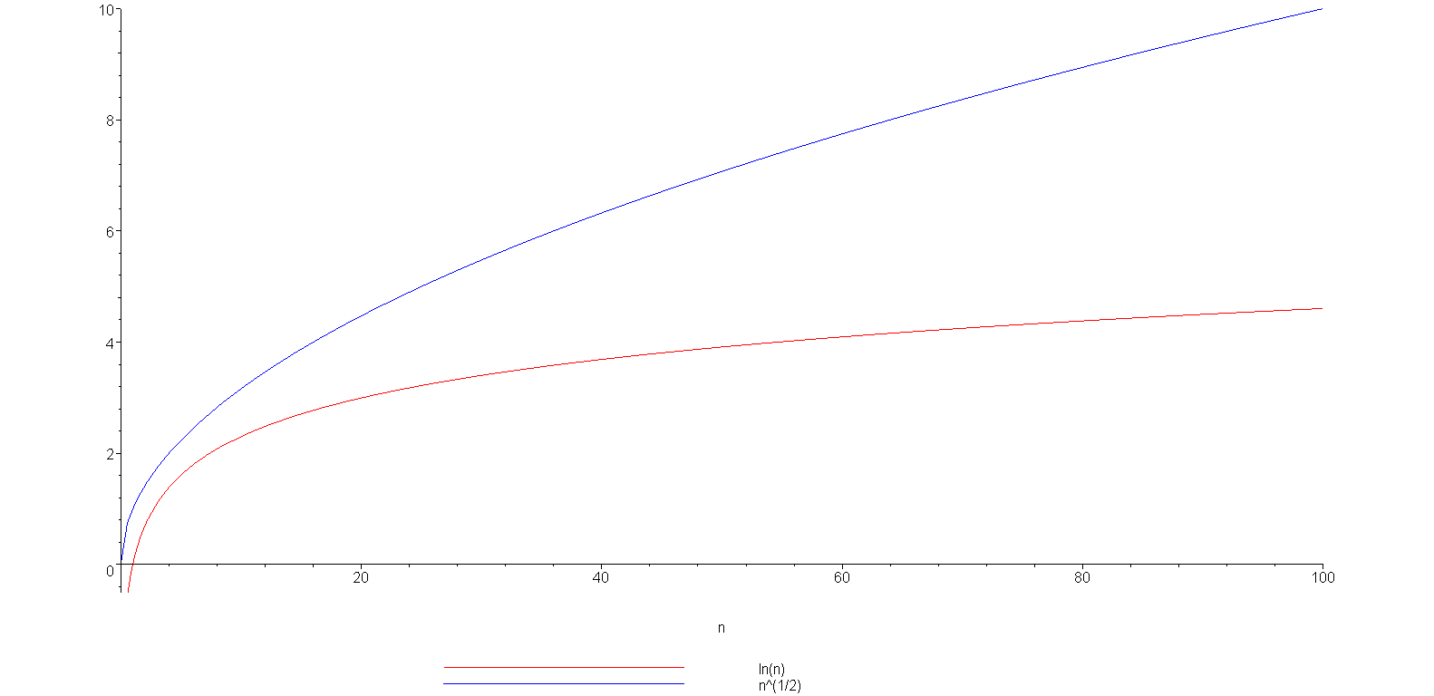
Logarithms
Example: is strictly greater than ln(n)
ln(n)

Slide 10
Arithmetic series
Next we will look various series
Each term in an arithmetic series is increased by a constant value (usually 1) :

Slide 11
Arithmetic series
Proof 1: write out the series twice and add each column
1 + 2 + 3 + . . . + n – 2 + n – 1 + n
+ n + n – 1 + n – 2 + . . . + 3 + 2 + 1
(n + 1) + (n + 1) + (n + 1) + . . . + (n + 1) + (n + 1) + (n + 1)
= n (n + 1)
Since we added the series twice, we must divide the result by 2

Slide 12
Other polynomial series
We could repeat this process, after all:
however, it is easier to see the pattern:

Slide 13
Outline
2.2
This topic will describe:
The concrete data structures that can be used to store information
The basic forms of memory allocation
Contiguous
Linked
Indexed
The prototypical examples of these: arrays and linked lists
Other data structures:
Stack
Queue
Trees
Finally, we will discuss the run-time of queries and operations on arrays and linked lists

Slide 14
Memory Allocation
2.2.1
Memory allocation can be classified as either
Contiguous
Linked
Indexed
Prototypical examples:
Contiguous allocation: arrays
Linked allocation: linked lists

Slide 15
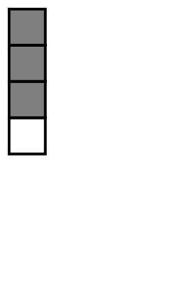
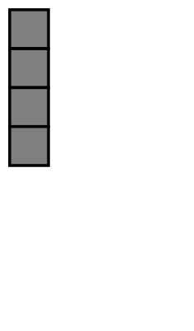
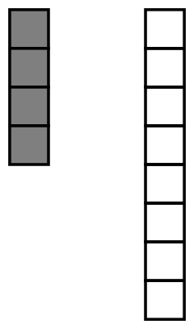
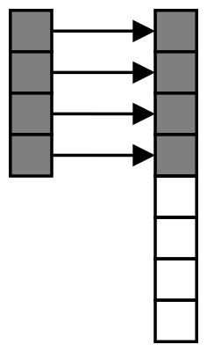
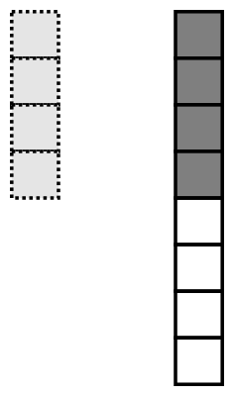
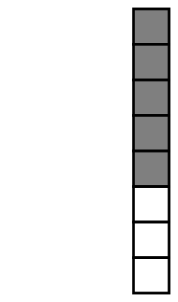

Contiguous Allocation
2.2.1
2.2.1.1
An array stores n objects in a single contiguous space of memory
Unfortunately, if more memory is required, a request for new memory usually requires copying all information into the new memory
In general, you cannot request for the operating system to allocate to you the next n memory locations

Slide 16

Linked Allocation
2.2.1.2
Linked storage such as a linked list associates two pieces of data with each item being stored:
The object itself, and
A reference to the next item
In C++ that reference is the address of the next node

Slide 17
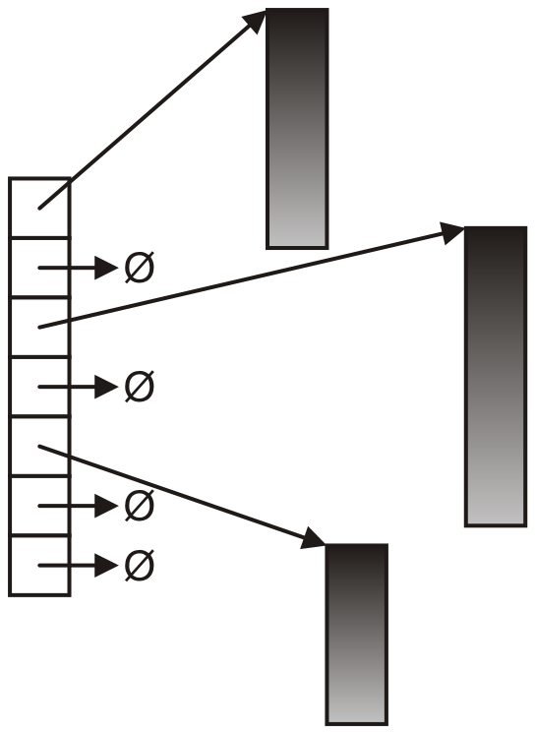
Indexed Allocation
2.2.1.3
With indexed allocation, an array of pointers (possibly NULL) link to a sequence of allocated memory locations
Used in the C++ standard template library
Computer engineering students will see indexed allocation in their operating systems course

Slide 18
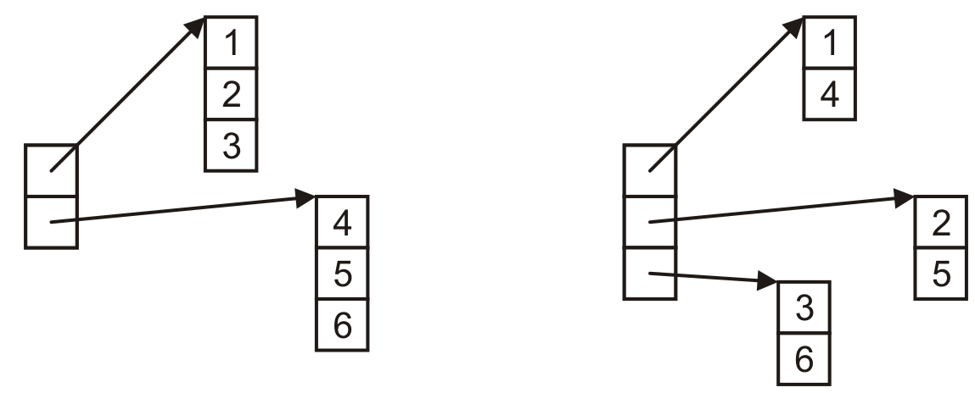
Indexed Allocation
2.2.1.3
Matrices can be implemented using indexed allocation:

Slide 19
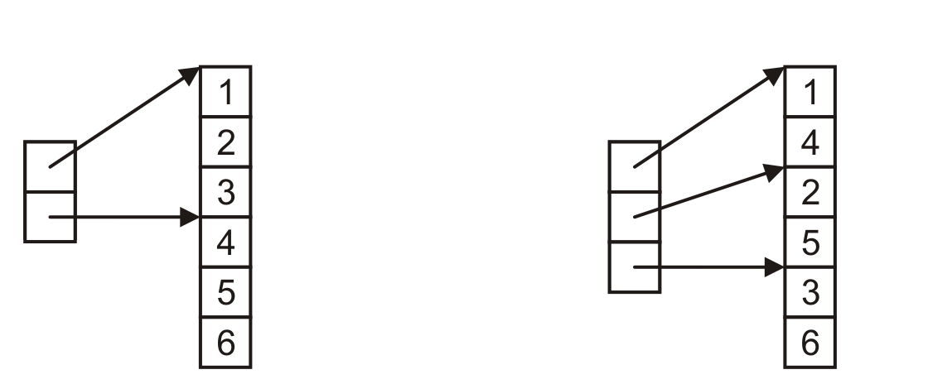
Indexed Allocation
2.2.1.3
Matrices can be implemented using indexed allocation
Most implementations of matrices (or higher-dimensional arrays) use indices pointing into a single contiguous block of memory
Row-major order
Column-major order

Slide 20
Other Allocation Formats
2.2.2
We will look at some variations or hybrids of these memory allocations including:
Trees
Graphs
Deques (linked arrays)

Slide 21
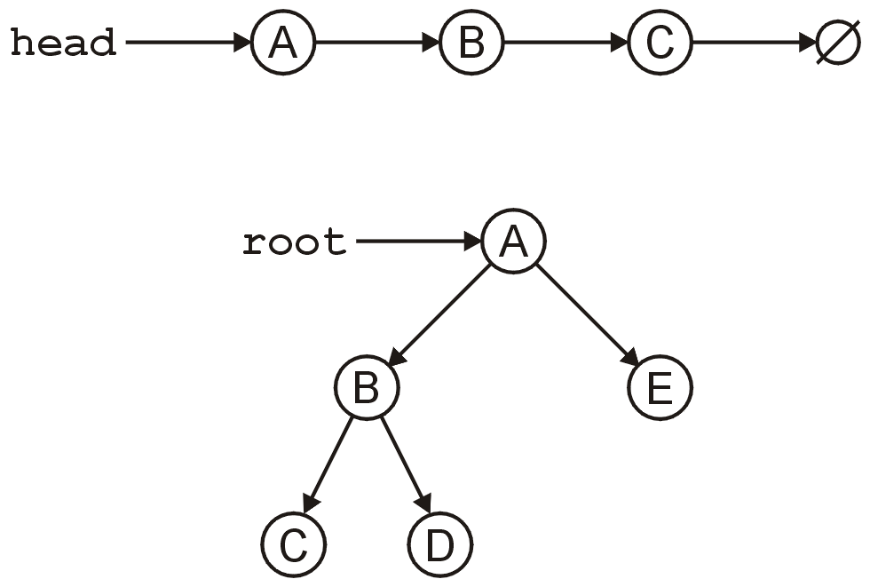
Trees
2.2.2.2
The linked list can be used to store linearly ordered data
What if we have multiple next pointers?
A rooted tree (weeks 4-6) is similar to a linked list but with multiple next pointers

Slide 22
Trees
2.2.2.2
A tree is a variation on a linked list:
Each node points to an arbitrary number of subsequent nodes
Useful for storing hierarchical data
We will see that it is also useful for storing sorted data
Usually we will restrict ourselves to trees where each node points to at most two other nodes

Slide 23
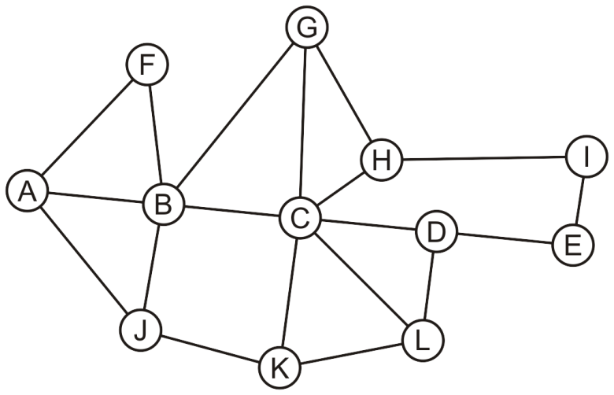
Arrays
2.2.2.2
Suppose we allow arbitrary relations between any two objects in a container
We could represent this using a two-dimensional array
In this case, the matrix is symmetric
 | A | B | C | D | E | F | G | H | I | J | K | L
A |  | × |  |  |  | × |  |  |  | ×
B | × |  | × |  |  | × | × |  |  | ×
C |  | × |  | × |  |  | × | × |  |  | × | ×
D |  |  | × |  | × |  |  |  |  |  |  | ×
E |  |  |  | × |  |  |  |  | ×
F | × | ×
G |  | × | × |  |  |  |  | ×
H |  |  | × |  |  |  | × |  | ×
I |  |  |  |  | × |  |  | ×
J | × | × |  |  |  |  |  |  |  |  | ×
K |  |  | × |  |  |  |  |  |  | × |  | ×
L |  |  | × | × |  |  |  |  |  |  | ×

Slide 24
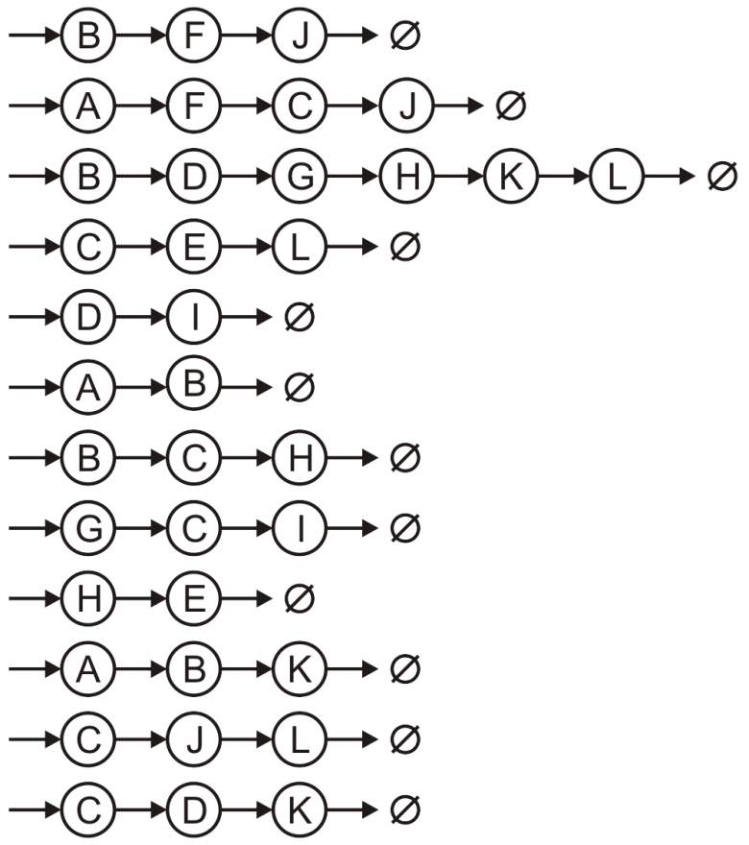
Array of Linked Lists
2.2.2.2
Suppose we allow arbitrary relations between any two objects in a container
Alternatively, we could use a hybrid: an array of linked lists
A
B
C
D
E
F
G
H
I
J
K
L

Slide 25
Algorithm run times
2.2.3
Once we have chosen a data structure to store both the objects and the relationships, we must implement the queries or operations as algorithms
The Abstract Data Type will be implemented as a class
The data structure will be defined by the member variables
The member functions will implement the algorithms
The question is, how do we determine the efficiency of the algorithms?

Slide 26
Operations
2.2.3
We will use the following matrix to describe operations at the locations within the structure
 | Front/1st | Arbitrary Location | Back/n^{th}
Find | ? | ? | ?
Insert | ? | ? | ?
Erase | ? | ? | ?

Slide 27
Operations on Sorted Lists
2.2.3.1
Given an sorted array, we have the following run times:
 | Front/1st | Arbitrary Location | Back/n^{th}
Find | Good | Okay | Good
Insert | Bad | Bad | Good* | Bad
Erase | Bad | Bad | Good
* only if the array is not full

Slide 28
Operations on Lists
2.2.3.2
 | Front/1st | Arbitrary Location | Back/n^{th}
Find | Good | Bad | Good
Insert | Bad | Bad | Good* | Bad
Erase | Bad | Bad | Good
* only if the array is not full
If the array is not sorted, only one operations changes:
Notes:
28

Slide 29
Background
2.3
Suppose we have two algorithms, how can we tell which is better?
We could implement both algorithms, run them both
Expensive and error prone
Preferably, we should analyze them mathematically
Algorithm analysis

Slide 30
Asymptotic Analysis
2.3.1
In general, we will always analyze algorithms with respect to one or more variables
We will begin with one variable:
The number of items n currently stored in an array or other data structure
The number of items expected to be stored in an array or other data structure
The dimensions of an n × n matrix
Examples with multiple variables:
Dealing with n objects stored in m memory locations
Multiplying a k × m and an m × n matrix
Dealing with sparse matrices of size n × n with m non-zero entries

Slide 31
Outline
In this topic, we will examine code to determine the run time of various operations
We will introduce machine instructions
We will calculate the run times of:
Operators +, -, =, +=, ++, etc.
Control statements if, for, while, do-while, switch

Slide 32
Machine Instructions
Given any processor, it is capable of performing only a limited number of operations
These operations are called instructions
The collection of instructions is called the instruction set
The exact set of instructions differs between processors

Slide 33
Machine Instructions
The C programming language (C++ without objects and other abstractions) can be referred to as a mid-level programming language
There is abstraction, but the language is closely tied to the standard capabilities
There is a closer relationship between operators and machine instructions
Consider the operation a += b;
Assume that the compiler has already has the value of the variable a in register D1 and perhaps b is a variable stored at the location stored in address register A1, this is then converted to the single instruction
ADD (A1), D1

Slide 34
Operators
Because each machine instruction can be executed in a fixed number of cycles, we may assume each operation requires a fixed number of cycles
The time required for any operator is Θ(1) including:
Retrieving/storing variables from memory
Variable assignment =
Integer operations + - * / % ++ --
Logical operations && || !
Bitwise operations & | ^ ~
Relational operations == != < <= => >
Memory allocation and deallocation new delete

Slide 35
Blocks of Operations
Each operation runs in Θ(1) time and therefore any fixed number of operations also run in Θ(1) time, for example:
// Swap variables a and b
int tmp = a;
a = b;
b = tmp;
// Update a sequence of values
// ece.uwaterloo.ca/~ece250/Algorithms/Skip_lists/src/Skip_list.h
++index;
prev_modulus = modulus;
modulus = next_modulus;
next_modulus = modulus_table[index];

Slide 36
Blocks in Sequence
Suppose you have now analyzed a number of blocks of code run in sequence
template <typename T>
void update_capacity( int delta ) {
T *array_old = array;
int capacity_old = array_capacity; array_capacity += delta;
array = new T[array_capacity];
for ( int i = 0; i < capacity_old; ++i ) {
array[i] = array_old[i];
}
delete[] array_old;
}
To calculate the total run time, add the entries: Θ(1 + n + 1) = Θ(n)
Θ(1)
Θ(n)
Θ(1) or Ω(n)

Slide 37
Control Statements
Given
if ( condition ) {
// true body
} else {
// false body
}
The run time of a conditional statement is:
the run time of the condition (the test), plus
the run time of the body which is run
In most cases, the run time of the condition is Θ(1)

Slide 38
Control Statements
In some cases, it is easy to determine which statement must be run:
int factorial ( int n ) {
if ( n == 0 ) {
return 1;
} else {
return n * factorial ( n – 1 );
}
}

Slide 39
Control Statements
In others, it is less obvious
Find the maximum entry in an array:
int find_max( int *array, int n ) {
max = array[0];
for ( int i = 1; i < n; ++i ) {
if ( array[i] > max ) {
max = array[i];
}
}
return max;
}

Slide 40
Condition-controlled Loops
The C++ for loop is a condition controlled statement:
for ( int i = 0; i < N; ++i ) {
// ...
}
is identical to
int i = 0; // initialization
while ( i < N ) { // condition
// ...
++i; // increment
}

Slide 41
Condition-controlled Loops
The initialization, condition, and increment usually are single statements running in Θ(1)
for ( int i = 0; i < N; ++i ) {
// ...
}

Slide 42
Condition-controlled Loops
The initialization, condition, and increment statements are usually Θ(1)
For example,
for ( int i = 0; i < n; ++i ) {
// ...
}

Slide 43
Condition-controlled Loops
For example,
int sum = 0;
for ( int i = 0; i < n; ++i ) {
sum += 1; Theta(1)
}
This code has run time
Θ(n·1) = Θ(n)

Slide 44
Condition-controlled Loops
Another example example,
int sum = 0;
for ( int i = 0; i < n; ++i ) {
for ( int j = 0; j < n; ++j ) {
sum += 1; Theta(1)
}
}
The previous example showed that the inner loop is Θ(n), thus the outer loop is
Θ(n·n) = Θ(n²)

Slide 45
Analysis of Repetition Statements
Suppose with each loop, we use a linear search an array of size m:
for ( int i = 0; i < n; ++i ) {
// search through an array of size m
// O( m );
}
The inner loop is O(m) and thus the outer loop is
O(n m)

Slide 46
Analysis of Repetition Statements
As another example:
int sum = 0;
for ( int i = 0; i < n; ++i ) {
for ( int j = 0; j < i; ++j ) {
for ( int k = 0; k < j; ++k ) {
sum += i + j + k;
}
}
}
From inside to out:
Θ(1)
Θ(j)
Θ(i²)
Θ(n³)

Slide 47
Serial Statements
Therefore:
if the leading term is big-Θ, then the result must be big-Θ, otherwise
if the leading term is big-O, we can say the result is big-O
For example,
O(n) + O(n²) + O(n⁴) = O(n + n² + n⁴) = O(n⁴)
O(n) + Θ(n²) = Θ(n²)
O(n²) + Θ(n) = O(n²)
O(n²) + Θ(n²) = Θ(n²)

